Slide 1

Kanban Board
A Simple Framework for Project Management
Yousef Afif – 1122382
Software Engineering-CSCI351

Slide 2

What is a Kanban Board?
A visual project management tool.
Helps teams manage workflows and tasks.
Originated from Toyota's production system to improve efficiency.
Widely used in Agile software development.

Slide 3
Key Principles of Kanban
Visualize the workflow: Use boards to track tasks.
Limit work in progress (WIP): Prevent bottlenecks.
Focus on flow: Maintain a steady flow of tasks.
Make process policies explicit: Define how work moves through stages.
Improve collaboratively, evolve experimentally

Slide 4

Key Components of a Kanban Board
Columns: Represent stages of work (e.g., To Do, In Progress, Done).
Cards: Represent individual tasks or work items.
WIP Limits: Restrict the number of tasks in each stage.

Slide 5
Benefits of Kanban in Software Engineering
• Improved visibility: Clear view of project progress.
• Faster delivery: Continuous delivery of features.
• Better team collaboration: Transparent workflow and task ownership.
• Enhanced flexibility: Easily adapt to changes in priorities.

Slide 6
How Kanban is Used in Software Engineering
• Task Management: Manage software development tasks like bug fixes, new features, and code reviews.
• Feature Development: Track the flow of user stories from backlog to completion.
• CI/CD Integration: Can be used in conjunction with Continuous Integration and Continuous Deployment pipelines.

Slide 7
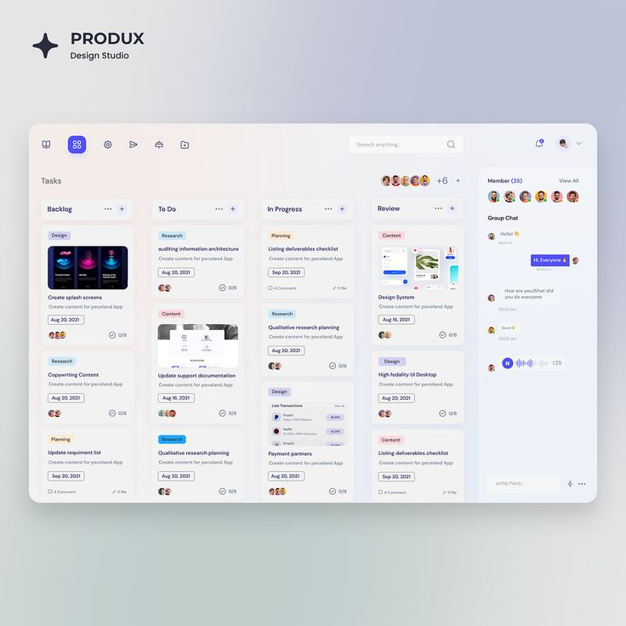
Real-Life Example
• Provide a simple Kanban board example specific to a software project.
• Columns: To Do, In Progress,
Code Review, Done
• Cards: Task 1 (New Feature), Task 2 (Bug Fix), etc.

Slide 8
Best Practices for Implementing Kanban
Keep it simple: Start with a basic board, and evolve it over time.
Set WIP limits: Prevent overload and focus on completing tasks.
Regularly review flow: Make adjustments based on bottlenecks.
Collaborate with the team: Ensure everyone understands the process.

Slide 9
Tools for Kanban
Trello: Simple and user-friendly for small teams.
Jira: Advanced features for software development teams.
Azure DevOps: Integrated with CI/CD tools for enterprise teams.
GitHub Projects: Kanban-style boards for code-related tasks.

Slide 10
Conclusion
Summary: Kanban is a flexible, visual tool that can significantly improve task management and workflow in software engineering.
Final Thought: By focusing on flow and minimizing bottlenecks, Kanban helps teams deliver software more efficiently and predictably.

Slide 11
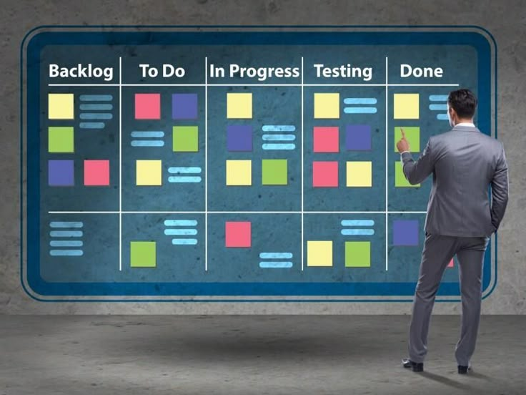
Thank you for listening

